Slide 1

Predicting water level fluctuations for Urban Water systems
GROUP 14:
1. Raghavendra Pothireddy - A04285579
2. Akhil Polsani - A04297393
3. Achyuth Kumar Pasupulati - A04296703
4. Rahul Gummal - A04297968
Notes:
Good morning/afternoon, everyone. Today, our team is excited to share our project on predicting water level fluctuations in urban water systems. This work is crucial as urban water systems are the backbone of our cities, supporting millions of people, industries, and ecosystems. By developing advanced models to predict these water levels, we aim to enhance resource
management and mitigate risks associated with water scarcity and floods.

Slide 2

Introduction
1. Importance of Urban Water Systems: Urban water systems are crucial for meeting the needs of growing populations, industries, and ecosystems. Accurate prediction of water level fluctuations is essential for effective resource management and risk mitigation.
2. Objective of the Project: The project aims to develop advanced predictive models using time-series data of water level fluctuations in urban water systems.
3. Challenges in Water Level Prediction: Predicting water level fluctuations in urban water systems faces challenges like complex dynamics, non-linear behaviors, and external influences such as weather and human activities.
Notes:
Our project specifically tackles the challenges posed by the complex and dynamic nature of these systems, influenced by various factors like weather changes and urban activities. Our goal is to provide robust tools for city planners and engineers to manage water resources proactively, ensuring sustainability and resilience against extreme conditions.

Slide 3
Introduction
4. Significance of Predictive Modeling: Advanced predictive models can provide valuable insights for decision-makers, enabling proactive management of urban water resources and infrastructure.
5. Expected Outcomes and Impact: The project is expected to improve resilience to extreme events, optimize resource allocation, and enhance sustainability of urban water systems through better predictive capabilities.

Slide 4
Related Work
1. Skarding, 2021: Offers a comprehensive survey on dynamic graph neural networks (GNNs), providing foundational insights into modeling techniques and applications.
2. Zhang, 2022: Explores the application of dynamic GNNs in sequential recommendation systems, highlighting their effectiveness in handling temporal data.
3. Lei, 2022 & Li, 2021: Introduce innovative approaches such as spatial-temporal graph convolutional networks (STGCNs) and spatial-temporal fusion graph neural networks for traffic flow prediction, showcasing advancements in modeling dynamic spatial-temporal data.
Notes:
In recent studies, techniques like dynamic graph neural networks have been employed to model complex systems dynamically. For instance, Skarding's 2021 survey provides foundational insights into these networks, which have been successfully applied in fields such as traffic flow prediction. By adapting similar models, we aim to capture the spatial and temporal dynamics of
water systems more effectively than traditional methods.

Slide 5
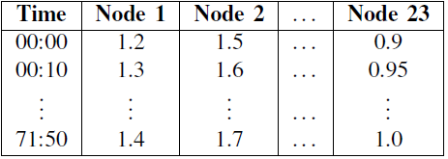
Dataset
1. The dataset comprises comprehensive dynamic data related to a water system, organized into two sheets for 23 nodes. This dataset offers a detailed view of the hydraulic performance and capacity utilization of the system.
2. The first sheet of the dataset contains time series data on water depth for each of the 23 nodes. Each row represents a specific time interval (e.g., 10 minutes), and each column corresponds to a different node in the water system. The values in the cells represent water depth measurements at the respective nodes for the corresponding time intervals.
3. With data recorded at regular intervals, such as 10-minute increments, the dataset provides a granular temporal resolution, allowing for detailed analysis of water depth fluctuations at each node over time. This temporal granularity enhances the understanding of the system's behavior and facilitates predictive modeling efforts.
Notes:
Our analysis is based on a comprehensive dataset that tracks water depth across 23 nodes within the urban water network, recorded at ten-minute intervals. This high granularity allows us
to closely monitor and predict changes in water levels, providing a detailed understanding of the system's behavior over time.

Slide 6
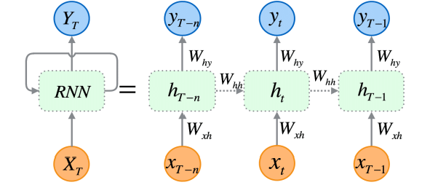
Baselines Used
RNN
1. Definition: Recurrent Neural Networks (RNNs) are a type of artificial neural network designed to process sequential data by maintaining a memory of previous inputs. This memory allows RNNs to exhibit temporal dynamics and capture dependencies within sequential data.
2. Sequential Processing: RNNs are particularly suited for tasks involving sequential data, such as time series analysis, natural language processing (NLP), speech recognition, and video processing. They can effectively model sequences of variable length.
3. Architecture: The basic architecture of an RNN consists of recurrent connections that allow information to persist over time. At each time step, the RNN processes an input vector and updates its hidden state, which serves as memory to store information from previous time steps.
Notes:
Recurrent Neural Networks (RNNs): These are ideal for time-series data like ours, as they can process sequences and remember previous inputs, which is crucial for predicting future water
levels. Multilayer Perceptrons (MLPs): These networks, although simpler, are powerful in finding patterns in data points spread across time and space. Graph Neural Networks (GNNs): Our main innovation lies in using GNNs, which excel in managing data structured as graphs — in our case, the network of water nodes and connections mimicking the city’s water system.

Slide 7
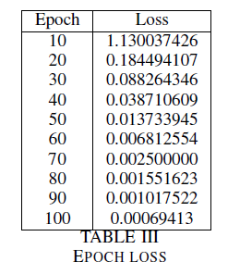
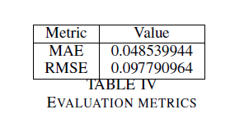
RNN

Slide 8
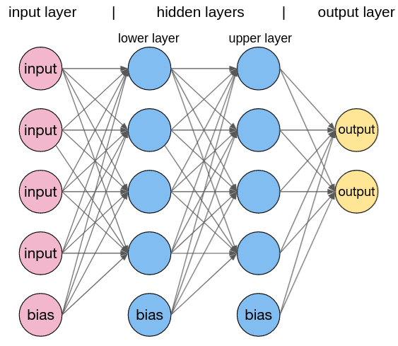
Baselines Used
2. MLP
1. Definition: Multilayer Perceptrons (MLPs) are a class of feedforward artificial neural networks consisting of multiple layers of interconnected nodes (neurons). MLPs are capable of learning complex nonlinear relationships between input and output data.
2. Feedforward Architecture: MLPs have a feedforward architecture, where information flows in one direction, from the input layer through one or more hidden layers to the output layer. Each layer except the input and output layers contains one or more neurons.
3. Activation Function: Each neuron in an MLP applies an activation function to its weighted sum of inputs, producing an output. Common activation functions include sigmoid, tanh, and rectified linear unit (ReLU), which introduce nonlinearity into the model, enabling it to learn complex patterns.
4. Hidden Layers: The hidden layers in an MLP are responsible for extracting and transforming features from the input data. The number of hidden layers and the number of neurons in each layer are hyperparameters that can be adjusted based on the complexity of the problem.

Slide 9
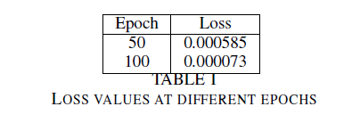
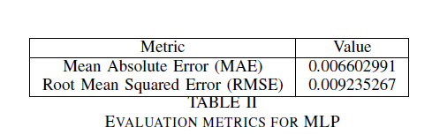
MLP

Slide 10
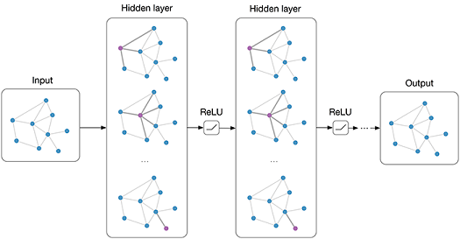
Proposed Method
Graph Neural Networks
1. Definition: Graph Neural Networks (GNNs) are a class of neural networks designed to operate on graph-structured data. Unlike traditional neural networks that operate on grid-like data such as images or sequences, GNNs can handle data with arbitrary graph structures, making them suitable for tasks involving relational data such as social networks, molecular structures, and citation networks.
2. Graph Representation: In GNNs, data is represented as a graph, consisting of nodes (vertices) and edges (connections) that represent relationships between nodes. Each node typically has associated features, and each edge may have associated attributes.
3. Message Passing: GNNs operate by passing messages between nodes in the graph. At each layer of the network, each node aggregates information from its neighboring nodes, applies a transformation function, and updates its own representation based on the aggregated information.

Slide 11
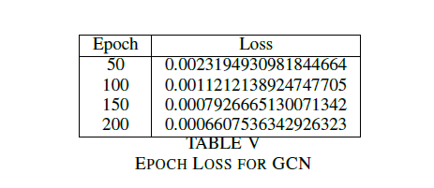
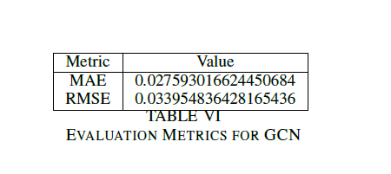
GNN

Slide 12
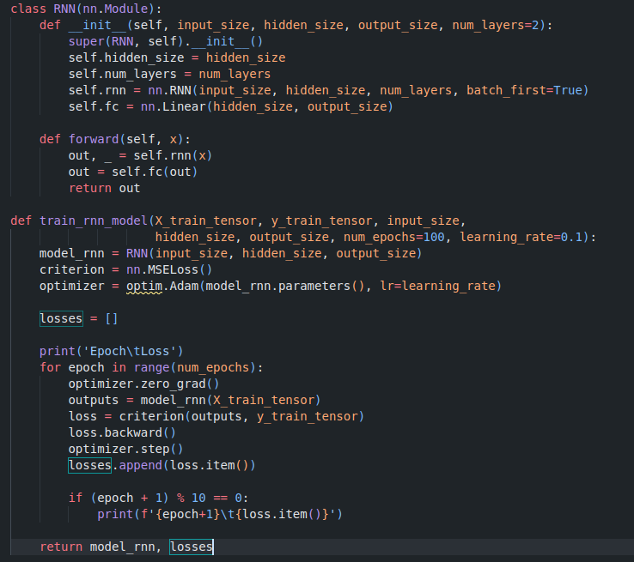
Code snippets (RNN)

Slide 13
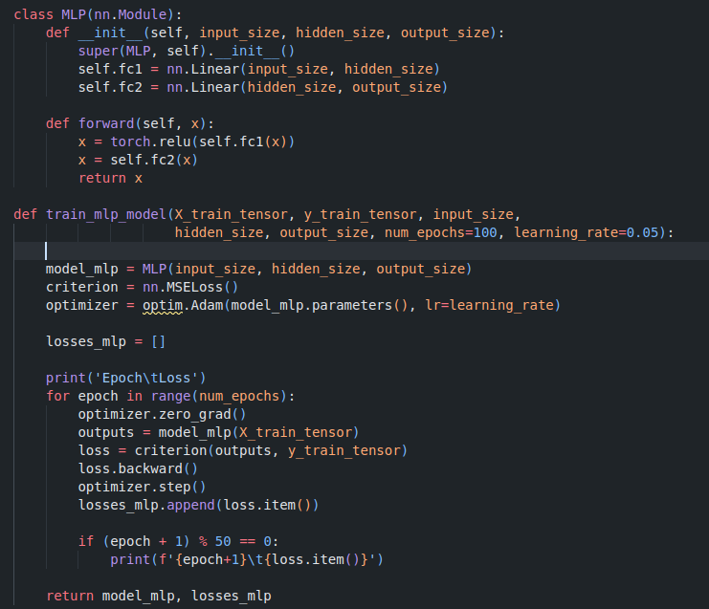
Code snippets (MLP)

Slide 14
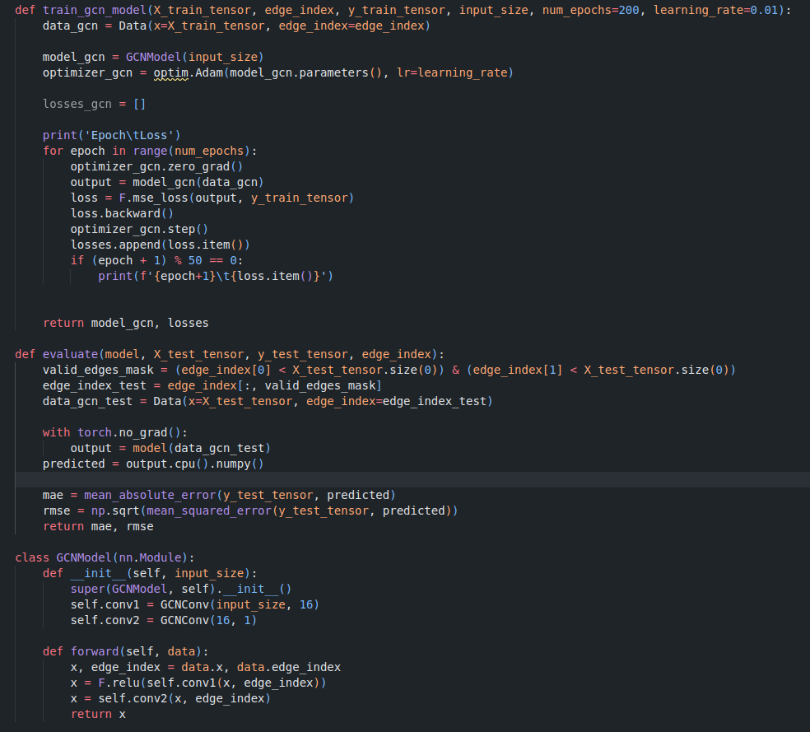
Code snippets (GNN)

Slide 15
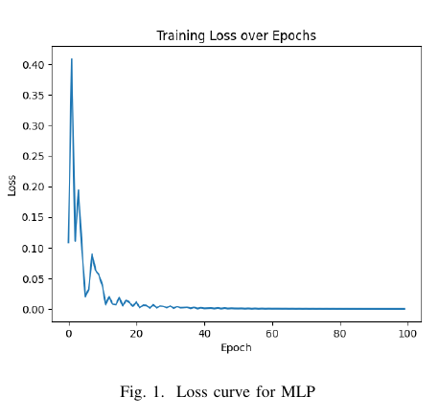
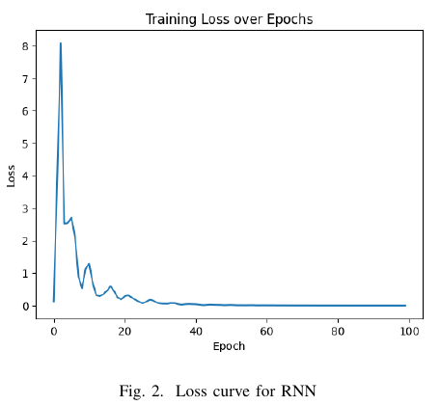
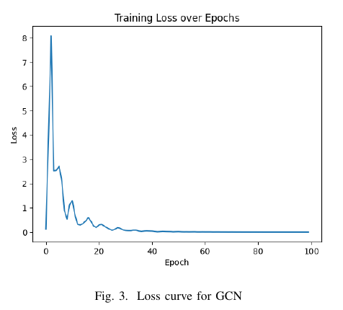
Results
Performance Comparison: The Mean Absolute Error (MAE) and Root Mean Squared Error (RMSE) metrics provide insights into the performance of different models. Among the three models evaluated, the GCN achieves the lowest MAE of 0.0066 and RMSE of 0.0092, indicating superior predictive accuracy compared to the RNN (Recurrent Neural Network) and MLP.
While the RNN and MLP demonstrate reasonable performance, with MAE values of 0.0485 and 0.0276, respectively, the GCN consistently achieves lower error rates across both metrics.
Notes:
In terms of performance, our preliminary results show that MLPs have achieved the lowest prediction errors with a Mean Absolute Error (MAE) of 0.0066 and a Root Mean Squared Error
(RMSE) of 0.0092. However, GNNs, although slightly less accurate now, show promise for improved performance as more data becomes available, thanks to their ability to integrate more complex relationships within the data.

Slide 16
Conclusion and Future Work
In conclusion, our project represents a significant step forward in the predictive management of urban water systems. With continued refinement, these models will help city planners not only
react to changes but also proactively manage water resources in anticipation of future conditions.
2. Looking ahead, we plan to integrate more diverse data sources, including weather patterns and urban growth projections, to further enhance the accuracy and reliability of our predictions.

Slide 17


